Slide 1
Python programming
unit 5 – turtle drawing

Slide 2

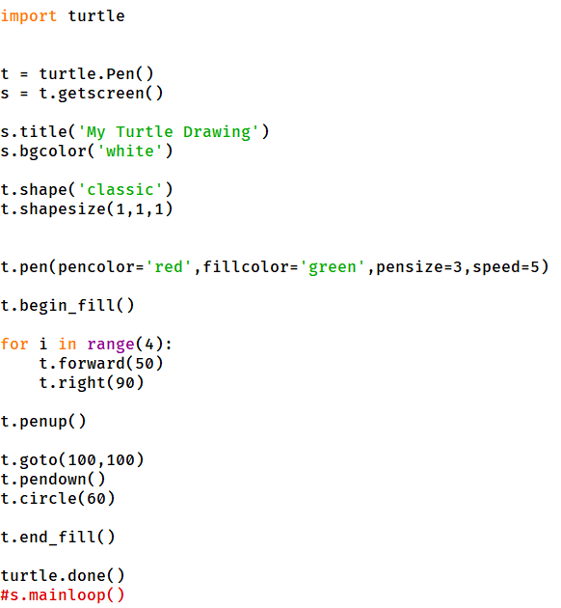
Drawing turtle in python
Include turtle module to be used
Create a Pen(Turtle) to be used
Screen is the canvas to be used
Set the screen and pen attributes
Start drawing and filling
End the program with this.

Slide 3
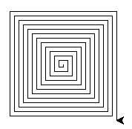
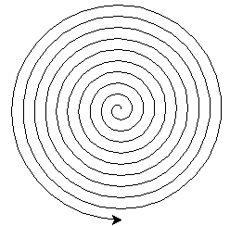
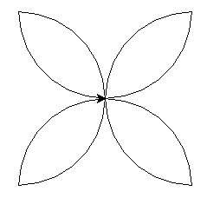
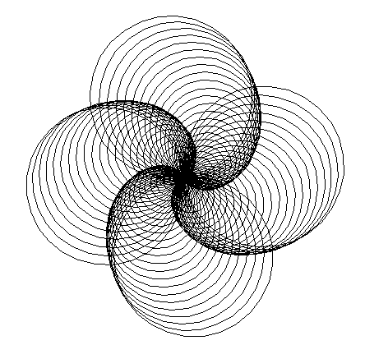
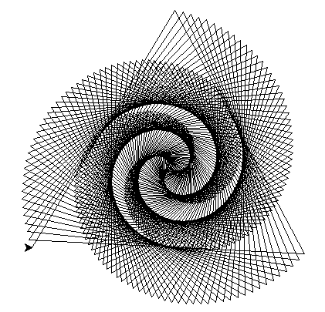
Drawing turtle in python

Slide 4
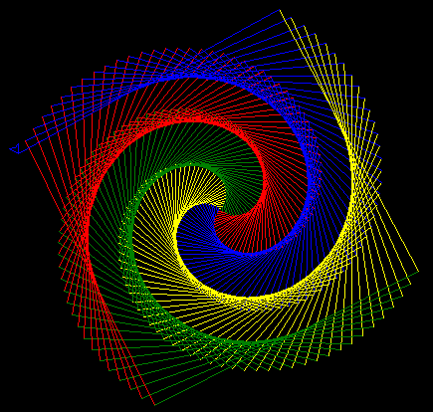
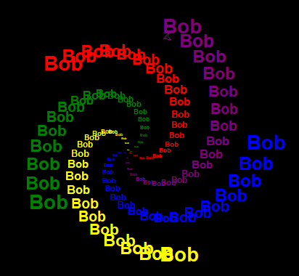
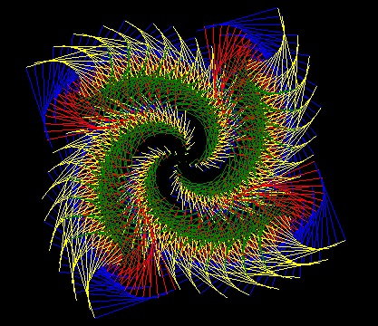
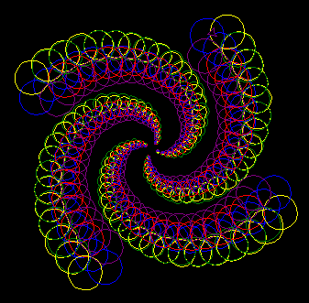
Drawing turtle in python

Slide 5
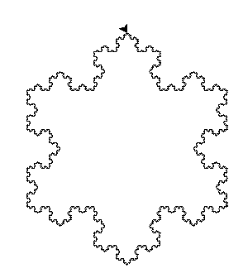
Snowflake and recursion
Recursion is a way of program, which a method calls itself, or through some others to call to itself.
Need a condition to broke the infinite loop.

Slide 6
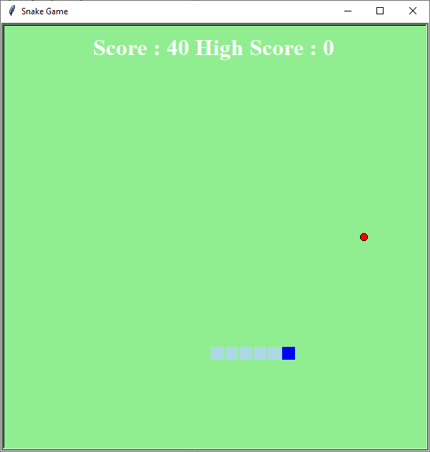
Snake game, using turtle module

Slide 7
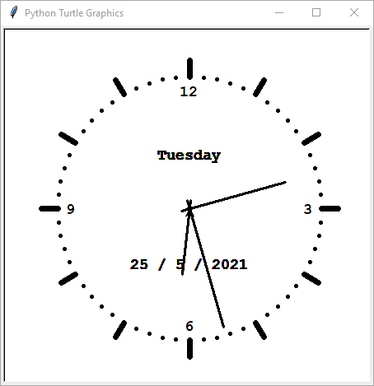
Clock program

Slide 8
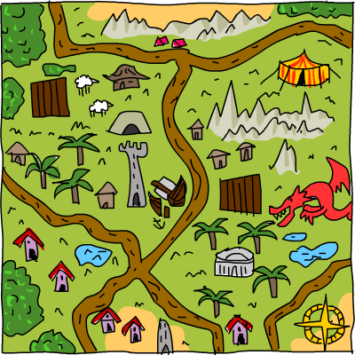
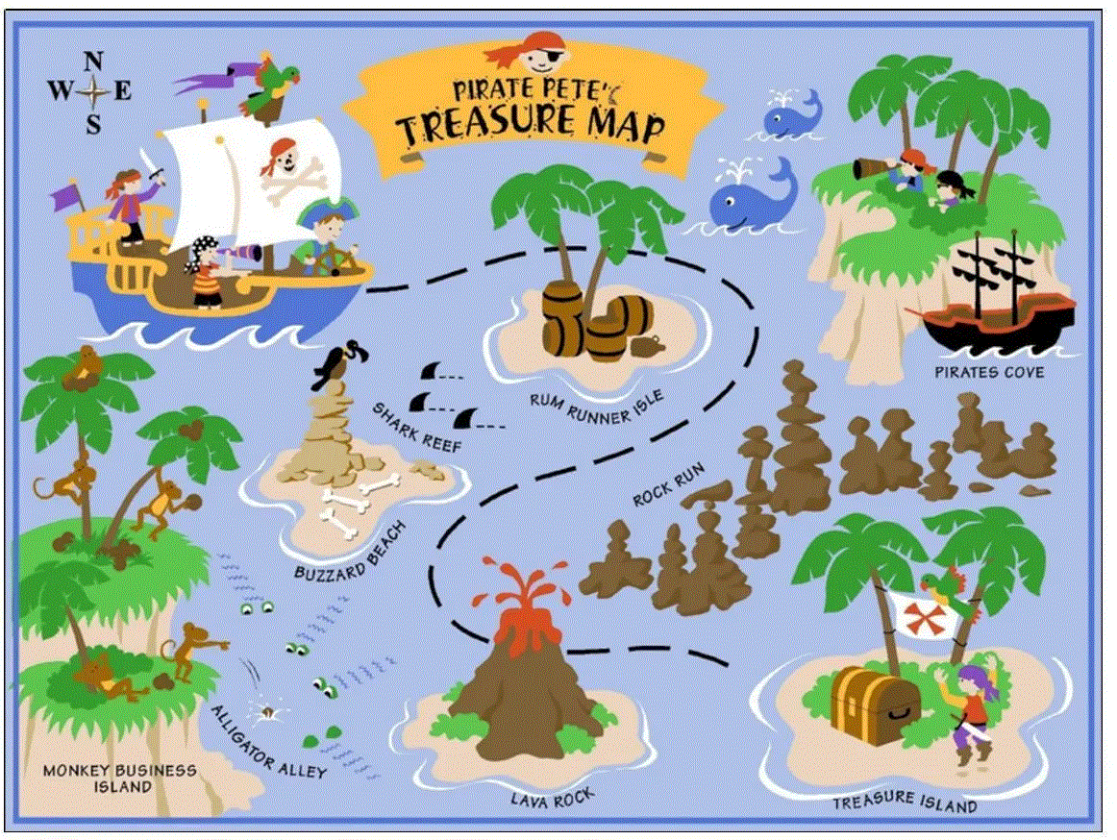
Treasure finding
Download a map. Search “treasure map” with google, or download the following one (https://nostarch.com/images/treasuremap.png)
Convert it to GIF and use it in turtle

